Slide 1




Online Survey
And
Data Collection
BSC/WD/23/42/05
W.M.I.T.Wanninayake

Slide 2


Table Of Contents
01
02
03
Introduction
System flow diagram
Wireframe
06
05
04
System Interface
Typography
Color pallet & Logo

Slide 3




01
Introduction

Slide 4



Project
Project Scenario
Online survey and data collection
Survey name –
Survey Muse

Slide 5






02
System flow diagram

Slide 6
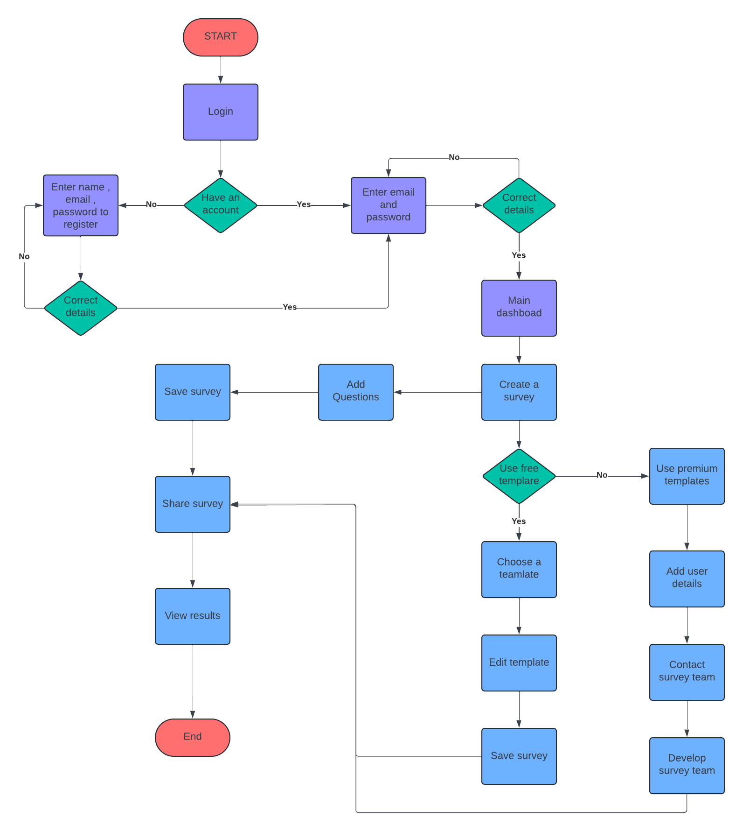

Slide 7


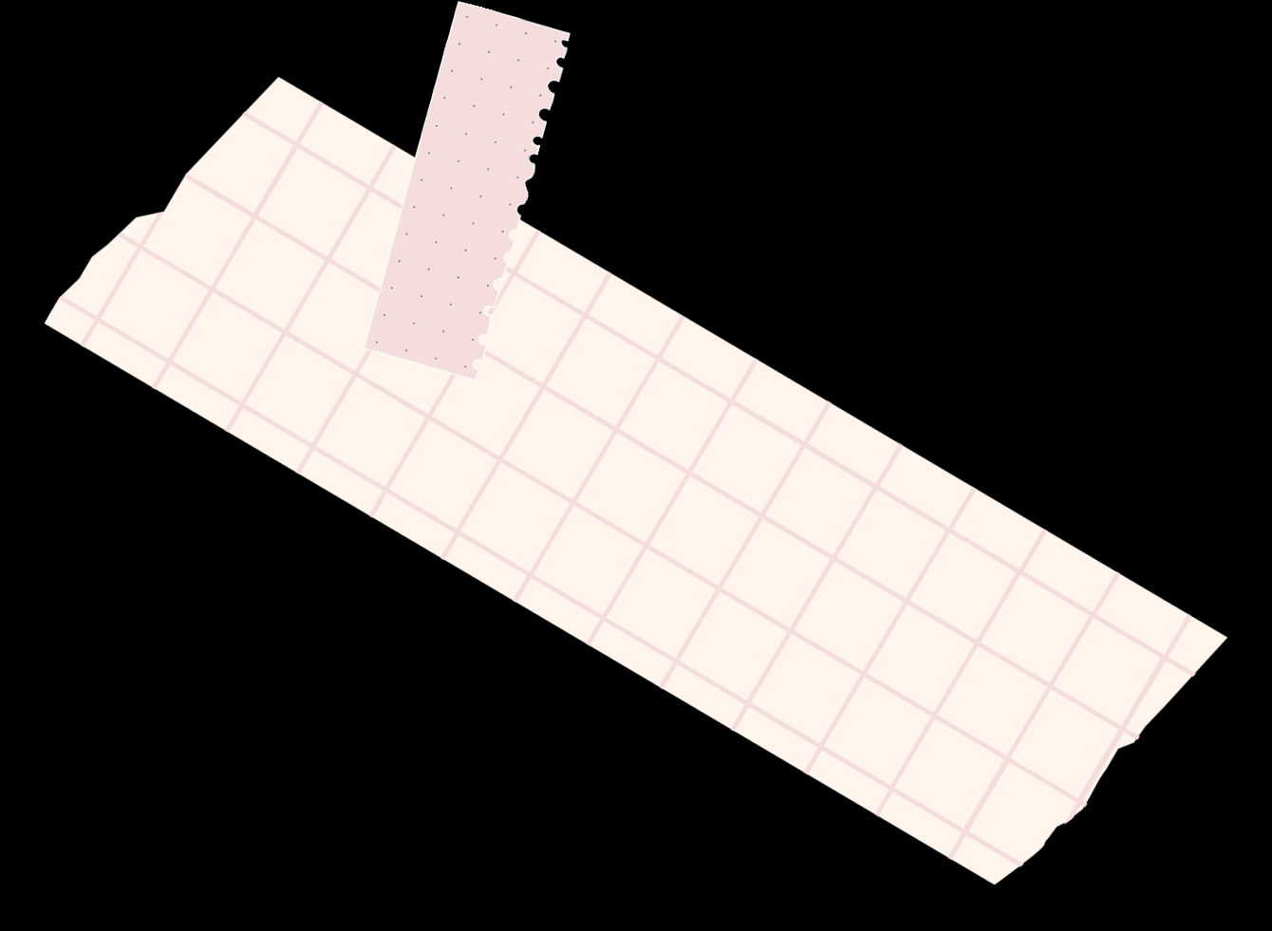

Wireframe
03

Slide 8
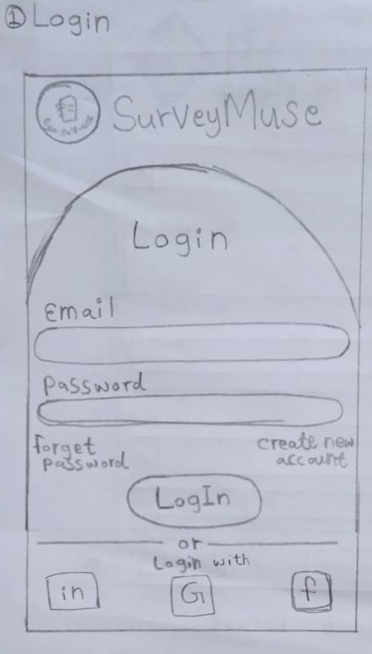
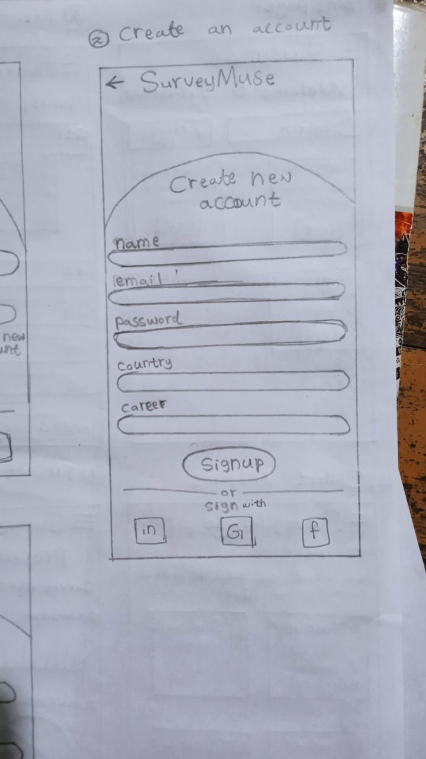
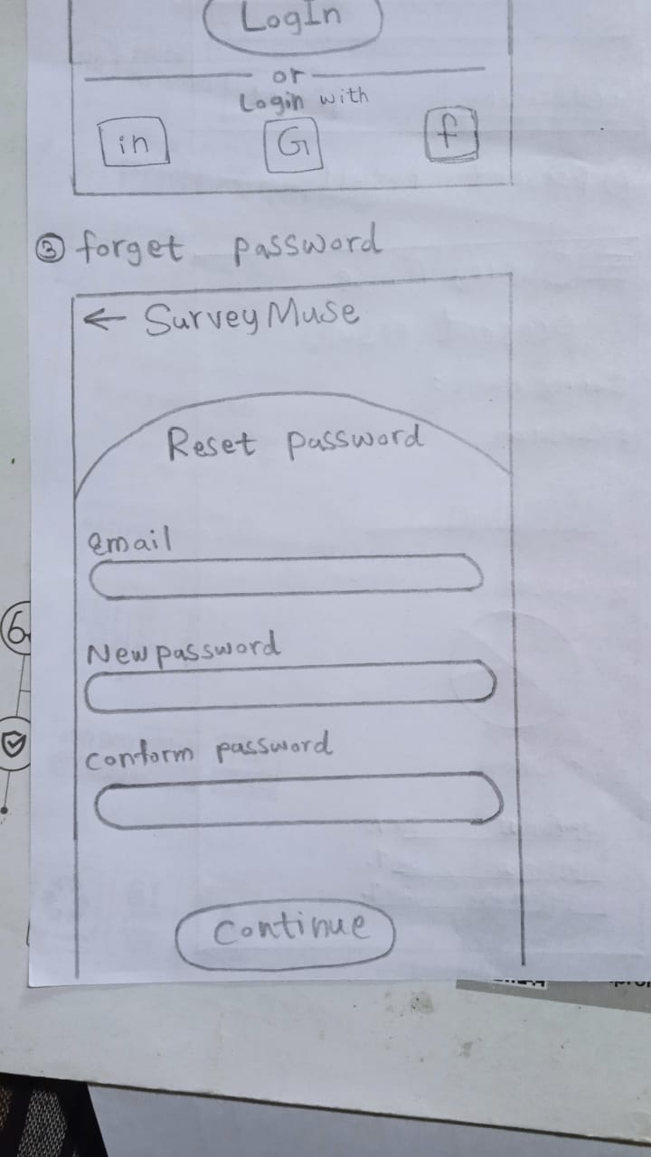

Slide 9
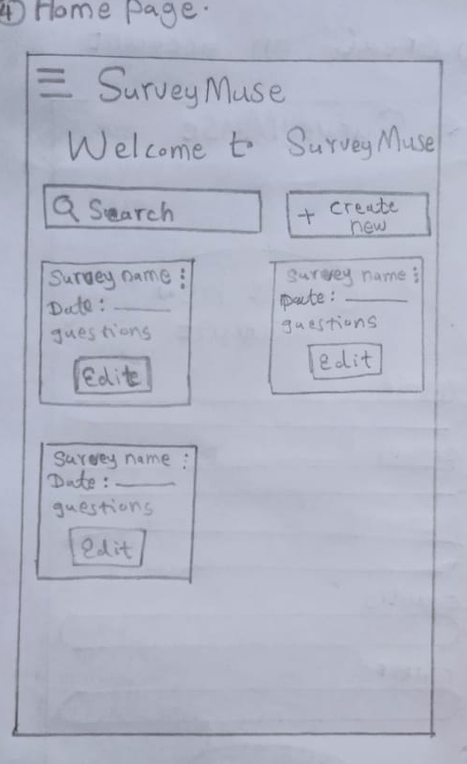
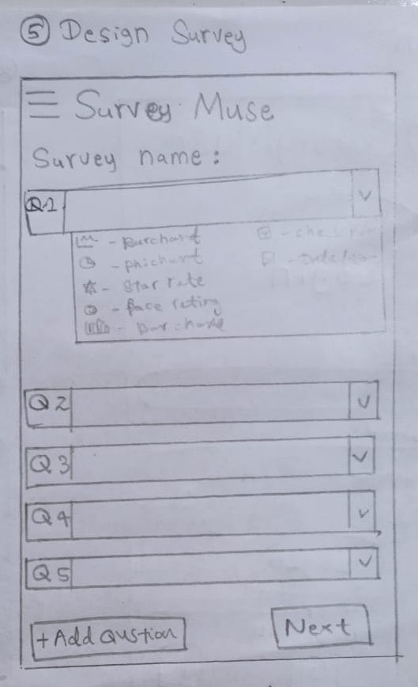
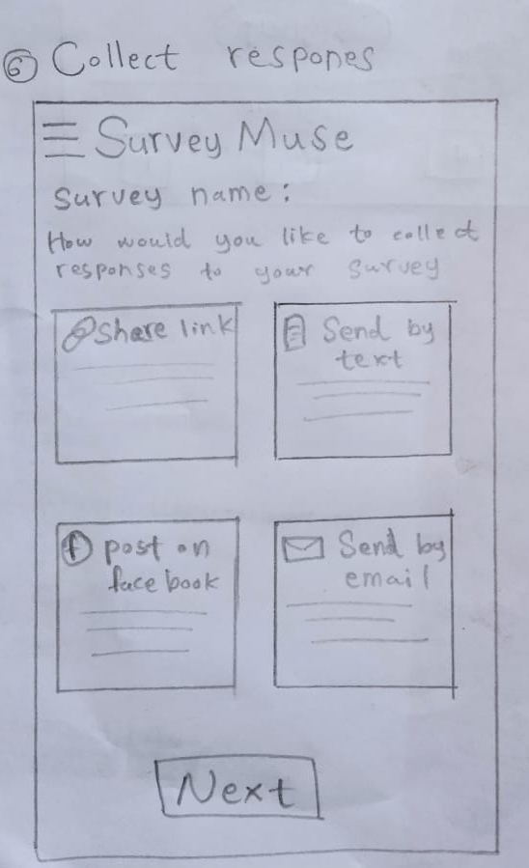

Slide 10
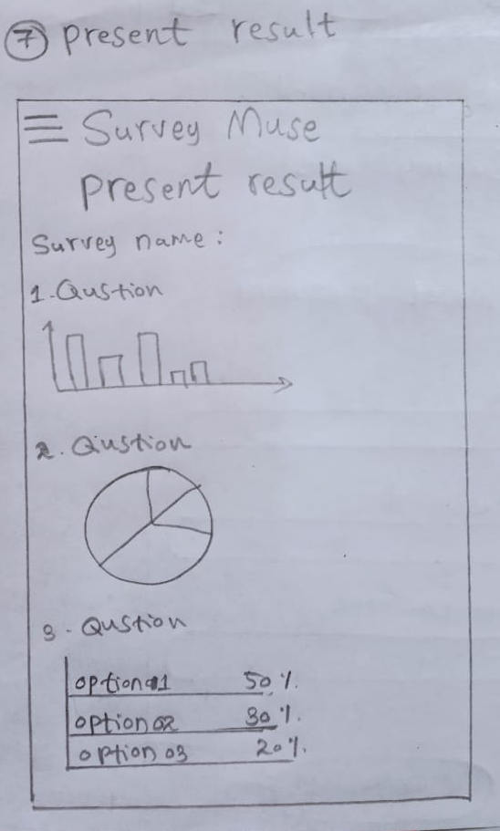
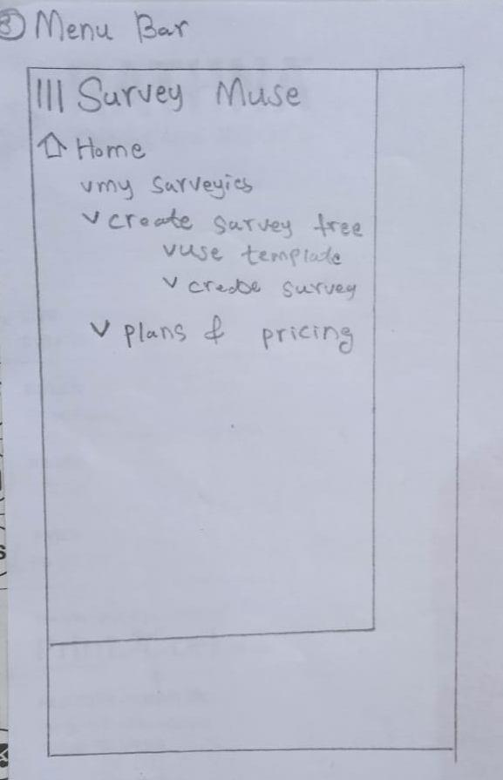
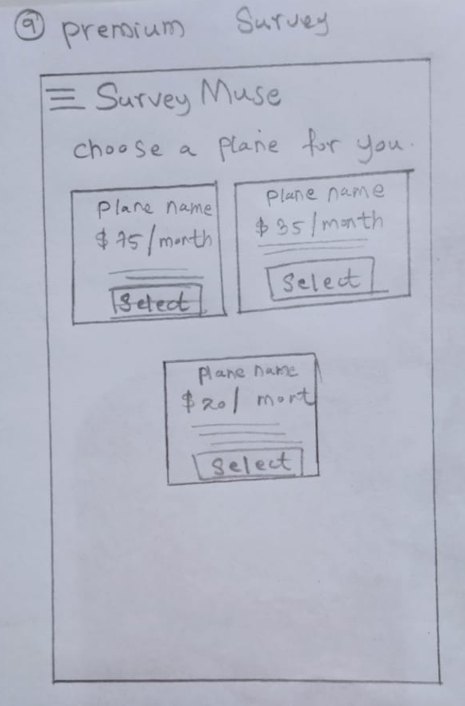

Slide 11
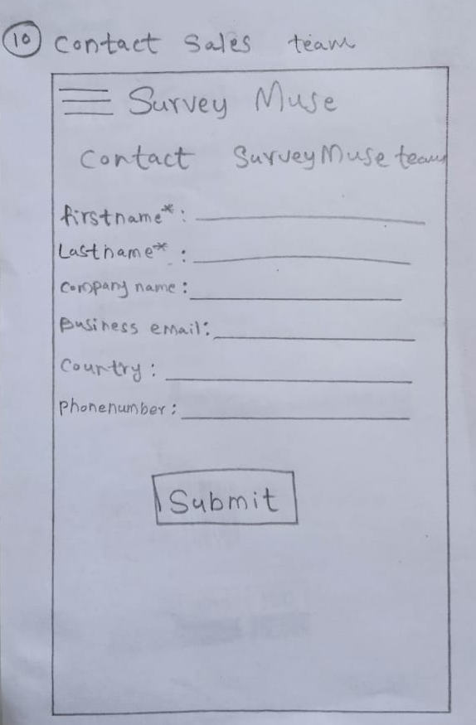
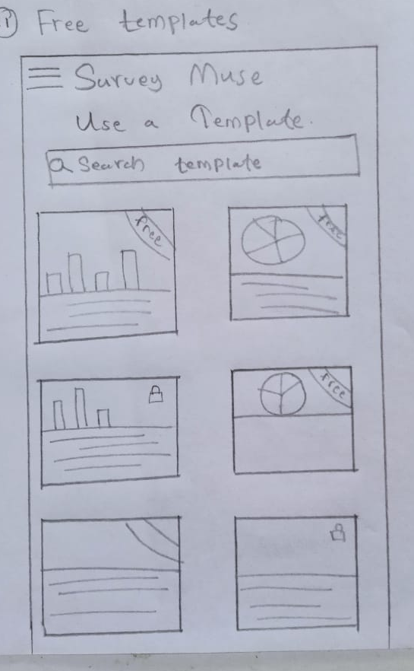

Slide 12

Color palate
04

Slide 13
Grey
Scale
#213A57
Primary Color
Secondary Color
Tertiary Color
#0B6477
Success
Warning
#0B6477
Error
#14199B
#80Ed99
#DC282B
#F39C11

Slide 14

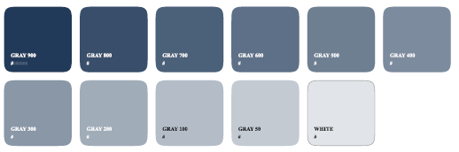
Grey Scale
Strong
Dependable
Elegant
Power full
Use for Background and icons

Slide 15
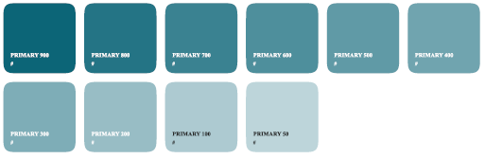
Primary color
Suggesting trust
Reliability
Professionalism
Elegant
Powerful

Slide 16
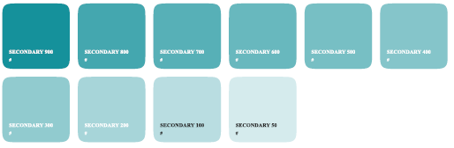
Secondary
color
Refreshing
Possibly call for accent or call to accent

Slide 17
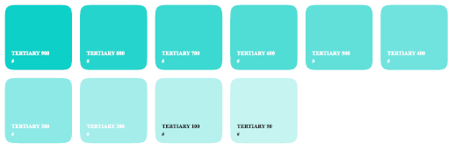
Tertiary
color
Clam
Relax
Free
Conveying Energy

Slide 18

Success
Elegant
Luxurious

Slide 19
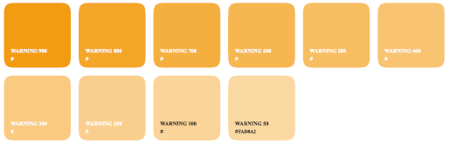
Warning
Signalling Attention
Energetic

Slide 20
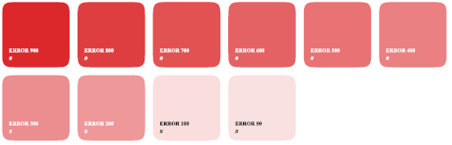
Error
Strong
Stable

Slide 21

Typography
05

Slide 22
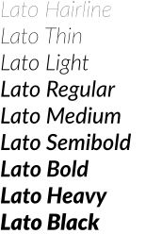

Slide 23
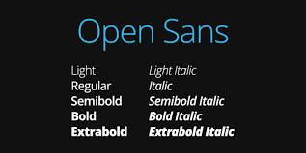

Slide 24
This both fonts are ,
Easy to Reade
Modern and Clear
Versatile

Slide 25


